Slide 1
Hybrid Quantum Hilbert-Space Feature Expansion Framework (HQHF-EEG)
Team Members:
SHANMUGHASUNDARAM P
NANDU G
RISHI R
THARUN ADITYA

Slide 2
Problem Statement
Epileptic seizure detection from EEG signals is critical for early diagnosis and treatment.
Classical machine learning models achieve 94–95% accuracy but rely on conventional feature extraction and classification.
EEG data is high-dimensional and nonlinear,limiting classical model performance.
Quantum feature maps project data into an exponentially large space, improving pattern separability and detection capability.

Slide 3
Objective
Design and implement a quantum kernel-based classifier for binary EEG seizure detection.
Develop and evaluate classical ML models and baseline quantum models for comparison.
Propose a hybrid Quantum Feature–Enhanced model to improve classification performance.
Evaluate models using Accuracy,Precision,Recall,F1-score,ROC-AUC, PR-AUC and Runtime.
Identify the best-performing approach based on performance and computational cost.

Slide 4
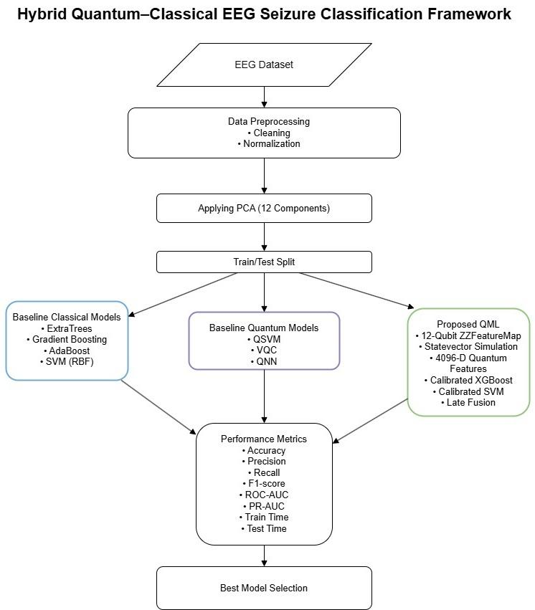
Implementation Details
We plan to implement the solution on Epileptic Seizure Recognition Dataset (Kaggle)
Data Preparation – Preprocessed EEG data, applied PCA (12 components) and performed stratified split.
Quantum Feature Mapping – Encoded features using 12-qubit ZZFeatureMap to generate 4096 probability features.
Classical Baselines:-Implemented ExtraTrees, Gradient Boosting,AdaBoost and SVM
Quantum Baselines – Evaluated QSVM, VQC and QNN models.
Proposed Model – Applied quantum feature expansion with calibrated XGBoost + SVM fusion and threshold tuning.
Evaluation – Measured Accuracy, Precision, Recall, F1, ROC-AUC, PR-AUC and runtime.

Slide 5
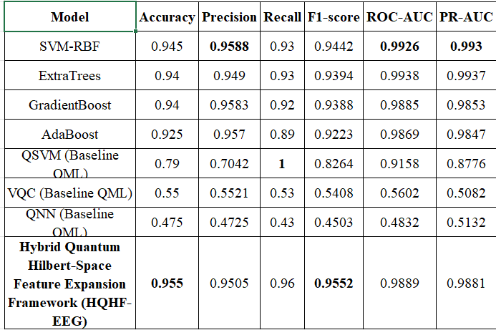
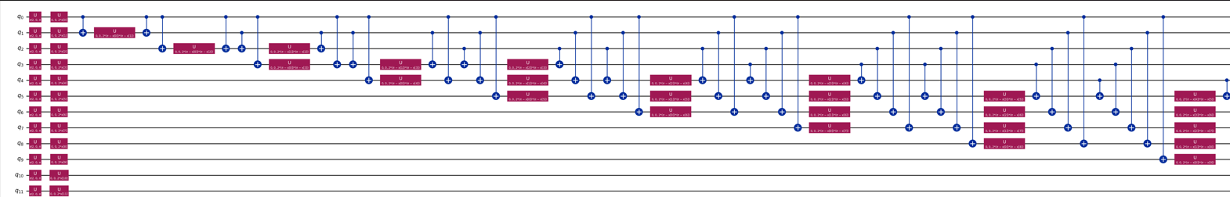
Results

Slide 6
Result Analysis & Conclusion
Achieved 95.5% accuracy and 0.955 F1-score,outperforming classical ML and baseline QML models.
High ROC-AUC (0.9889) shows strong separability in the quantum Hilbert space.
Classical SVM was competitive, but the hybrid model delivered better overall performance.
Baseline quantum models showed significantly lower accuracy.
State Vector simulation increases computational cost (2¹² dimensional expansion).
Implementation is simulation-based, not tested on real quantum hardware.
Scalability may be limited as qubit count increases.
Future work includes testing on real quantum devices.
Extend to multi-class seizure detection and larger clinical datasets.

Slide 7
Thank you

